Slide 1
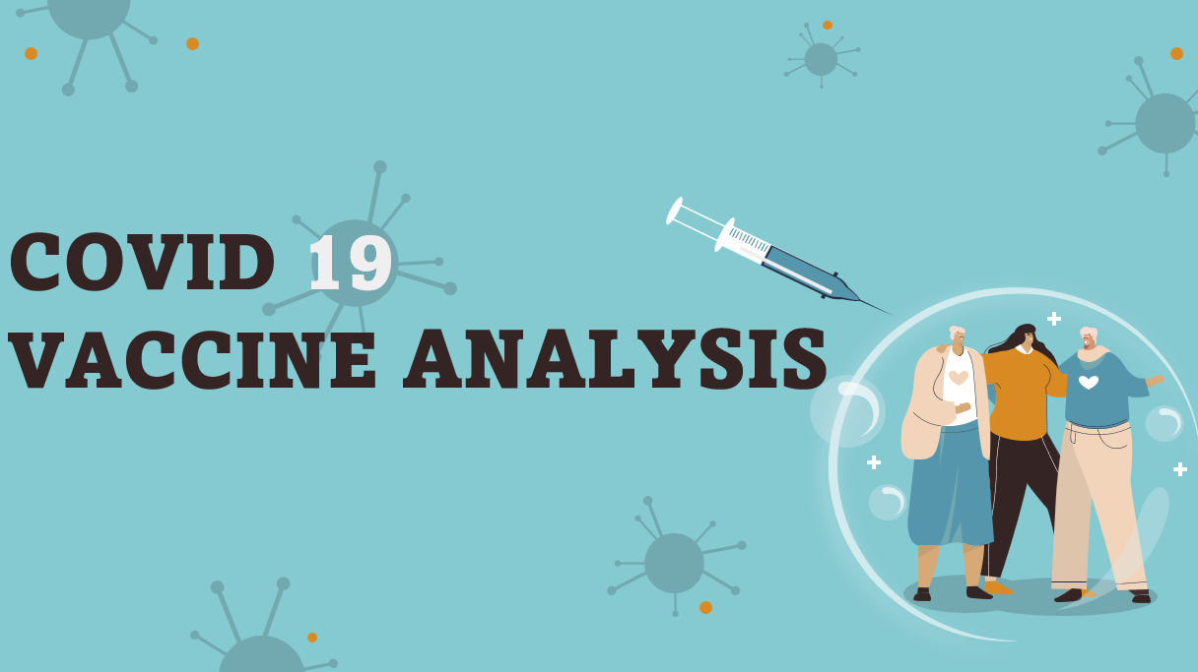

Slide 2
Abstract
In this analysis, we explored a comprehensive dataset on COVID-19 vaccination progress across different countries. The dataset includes information on daily vaccination numbers, total vaccinations administered, vaccine types, and more. Our goal was to gain insights into the global vaccination effort, understand vaccination trends over time, and identify factors influencing vaccination rates.
Key Findings and Insights
Global Vaccination Trends
Vaccine Types
Temporal Trends
Regional Disparities
Correlation Analysis

Slide 3
Objective
some math to understand it better, and making visuals to explain it clearly. The hope is that by doing this, we can give a good picture of how the vaccines are doing and help in the fight against Covid-19.
The project aims to thoroughly analyze Covid-19 vaccine data with key objectives:
evaluating vaccine efficacy
scrutinizing distribution strategies
investigating adverse effects
providing actionable insights
By achieving these goals, the project seeks to enhance decision-making for policymakers and health organizations, fostering optimized deployment strategies in the ongoing battle against the Covid-19 pandemic.

Slide 4
Design & thinking
Data Preprocesing
Exploratory Data Analysis(EDA)
Statistical Analysis
Virtualization
Insights and Recommendation
Data Collection

Slide 5
Exploratory Data Analysis
Calculate summary statistics for relevant columns (mean, median, standard deviation, etc.).
Create various visualizations to explore trends and patterns, such as:
Time series plots of vaccination progress over time.
Bar charts to compare vaccination rates among countries.
Heatmaps to identify correlations between variables.
Analyze the geographical distribution of vaccination progress using world maps.

Slide 6
Statistical Analysis
Conduct hypothesis testing to answer specific research questions (e.g., comparing vaccination rates between countries using t-tests).
Use regression analysis to model the impact of variables (e.g., vaccine type or GDP) on vaccination rates.

Slide 7
Visualization
Develop informative and visually appealing charts and graphs.
Consider creating interactive visualizations for online sharing or presentations.
Ensure that your visualizations are well-labeled and easy to interpret.

Slide 8



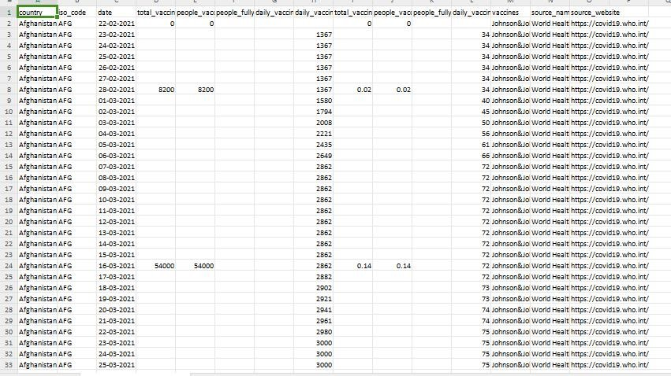

Slide 9
Program FOR EDA:
import pandas as pd
import numpy as np
import seaborn as sns
import matplotlib.pyplot as plt
url = "data.csv"
data = pd.read_csv(url)
print("Basic Info:")
print(data.info())
print("\nSummary Statistics:")
print(data.describe())
print("\nMissing Values:")
print(data.isnull().sum())
print("\nData Types:")
print(data.dtypes)
categorical_columns = data.select_dtypes(include=['object'])
print("\nUnique Values in Categorical Columns:")
for col in categorical_columns.columns:
unique_values = data[col].nunique()

Slide 10
print(f"{col}: {unique_values} unique values")
numeric_data = data.select_dtypes(include=['number'])
for col in numeric_data.columns:
plt.figure(figsize=(6, 6))
sns.histplot(data=data, x=col, kde=True, bins=20)
plt.title(f"Distribution of {col}")
plt.xlabel(col)
plt.ylabel("Frequency")
plt.show()
for col in categorical_columns.columns:
plt.figure(figsize=(6, 6))
sns.boxplot(data=data[0:2500], x=col, y='total_vaccinations')
plt.title(f"Box Plot of Total Vaccinations by {col}")
plt.xticks(rotation=10)
plt.xticks(fontsize=6)
plt.show()
plt.figure(figsize=(10, 6))
sns.lineplot(data=data, x=data.index, y='total_vaccinations')
plt.title("Total Vaccinations Over Time")
plt.xlabel("Date")
plt.ylabel("Total Vaccinations")
plt.xticks(rotation=45)
plt.show()

Slide 11
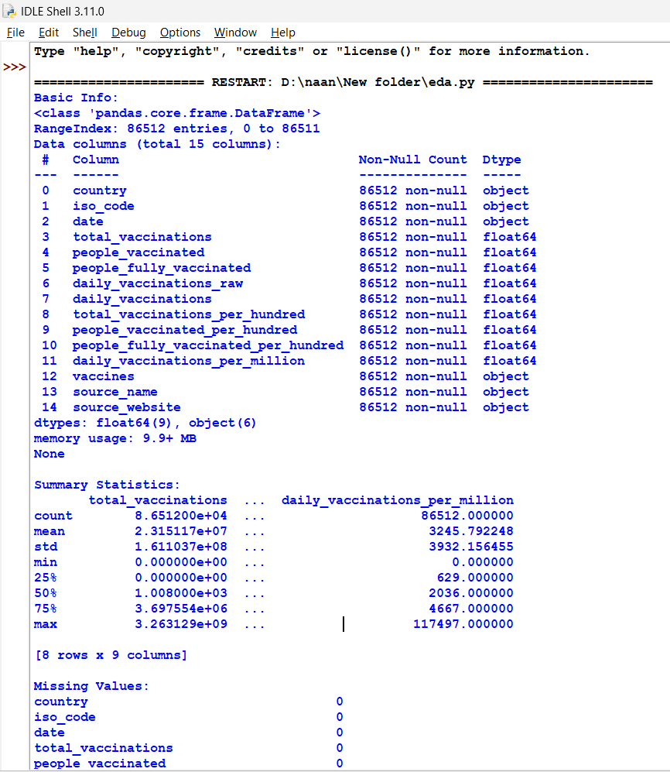
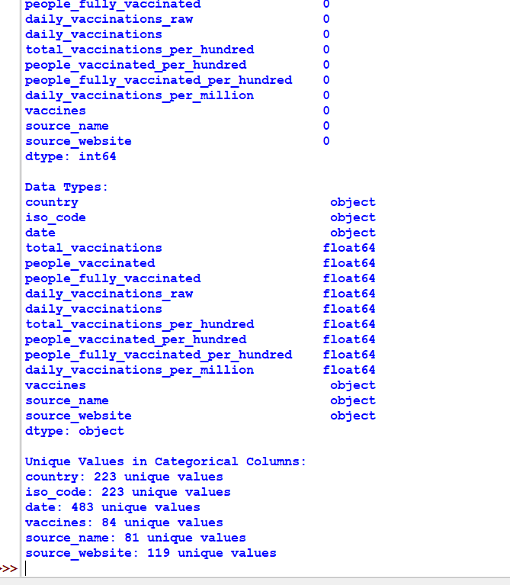
Output:

Slide 12
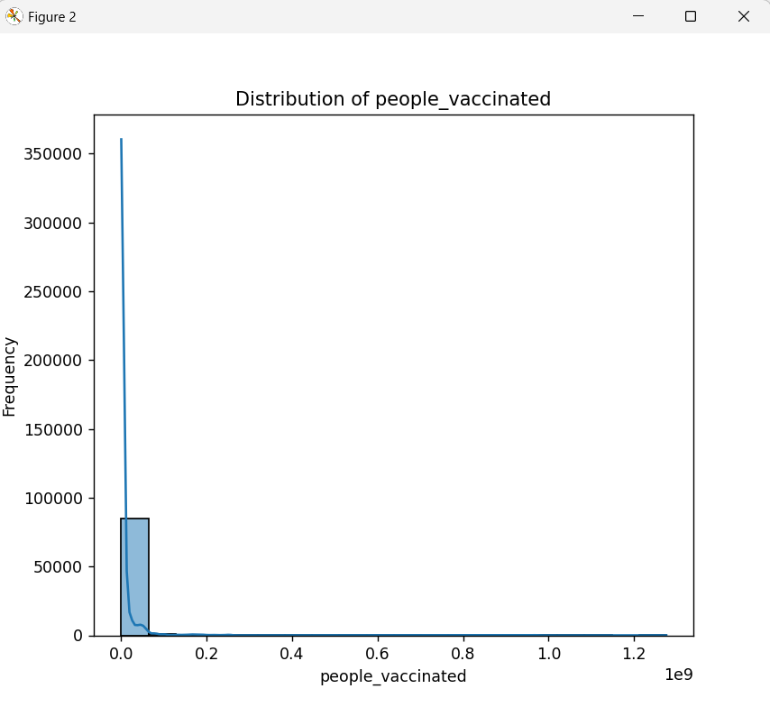
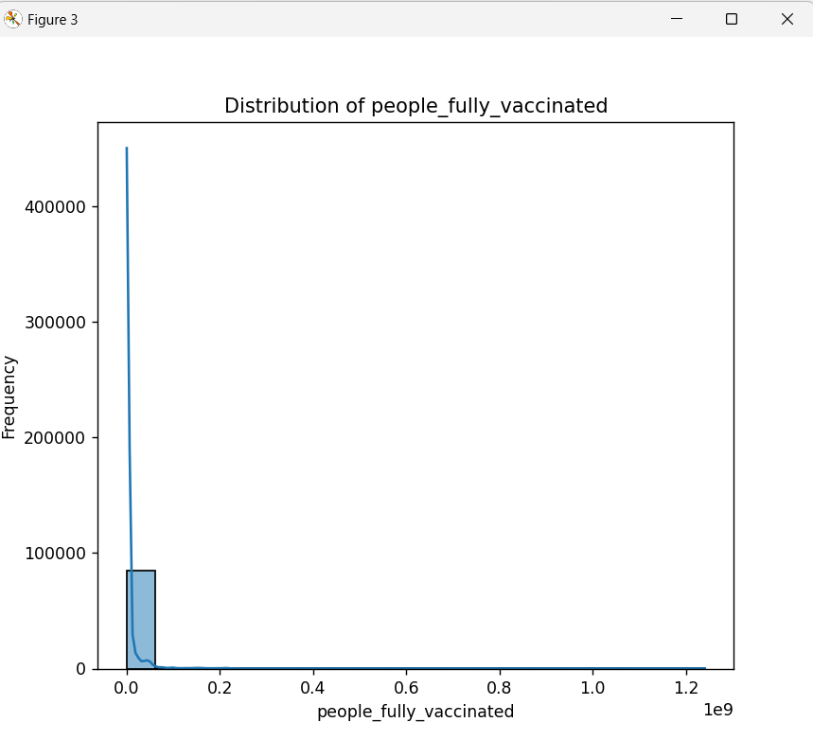
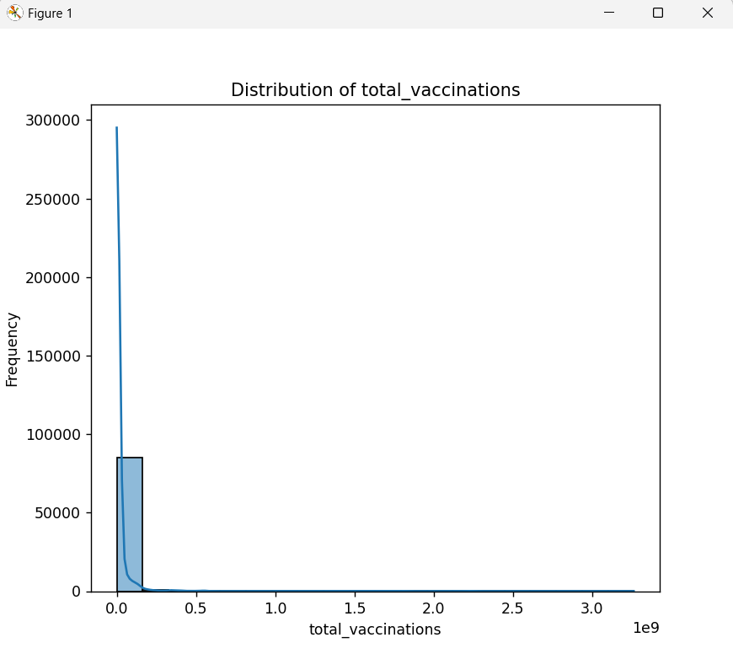
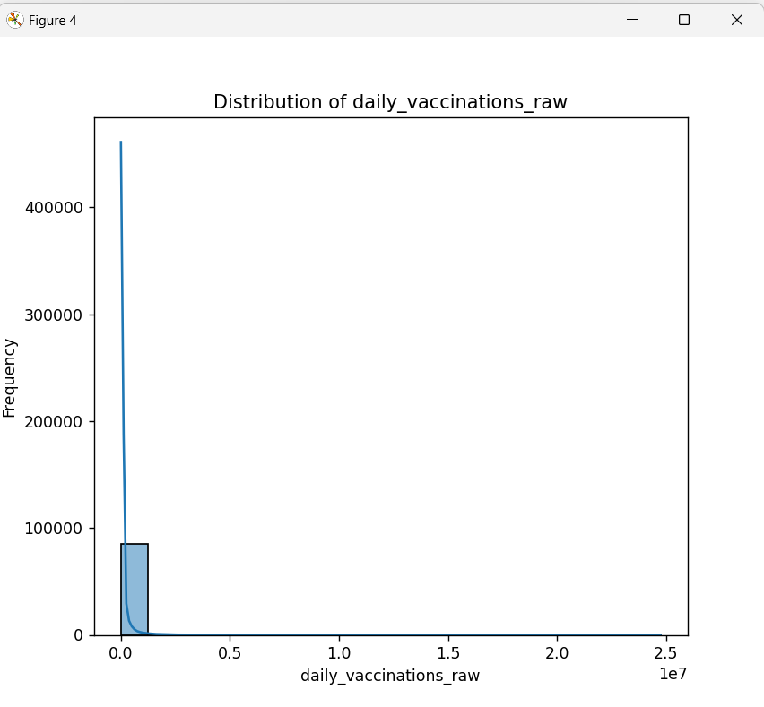
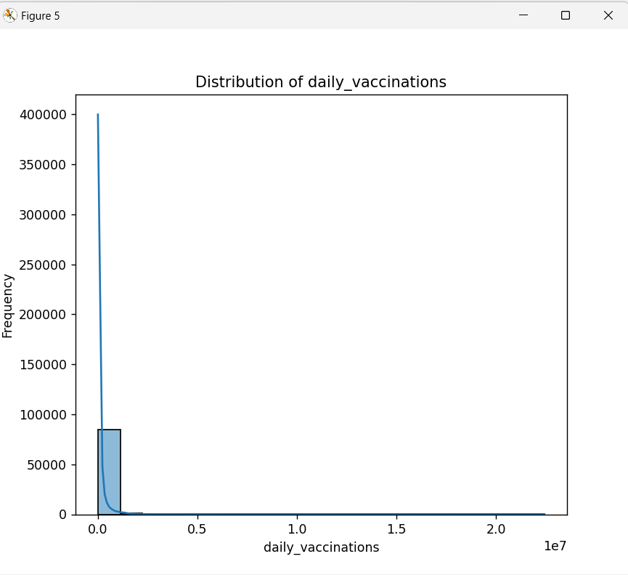
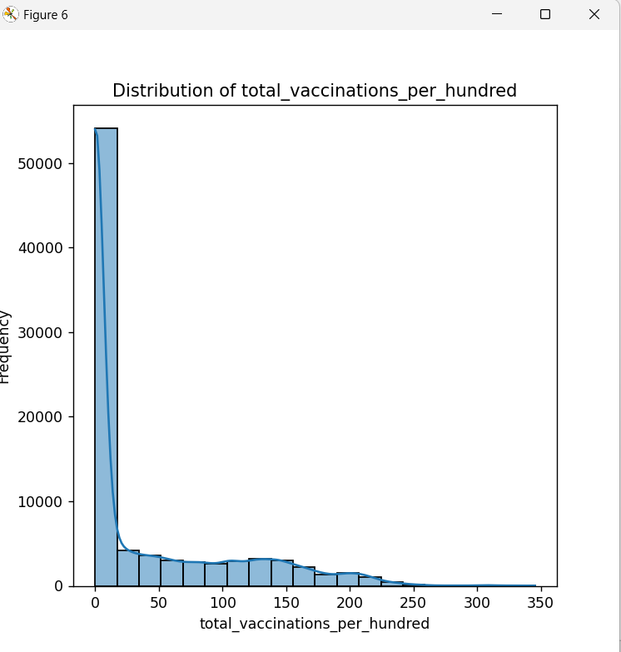

Slide 13
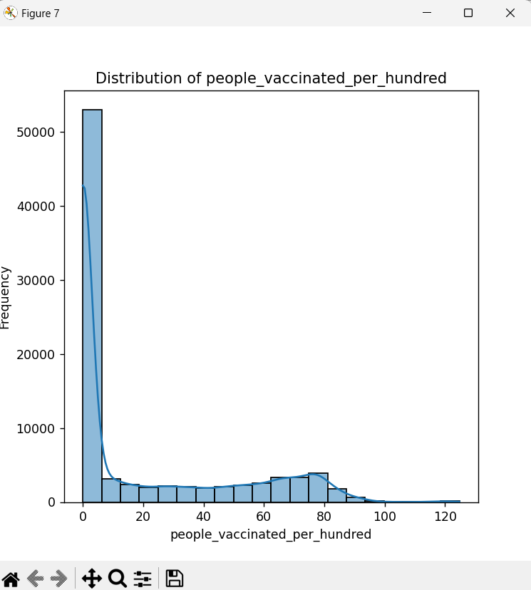
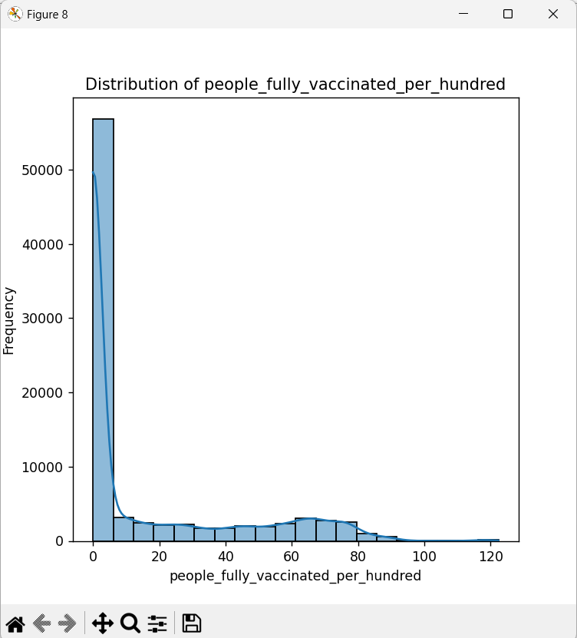
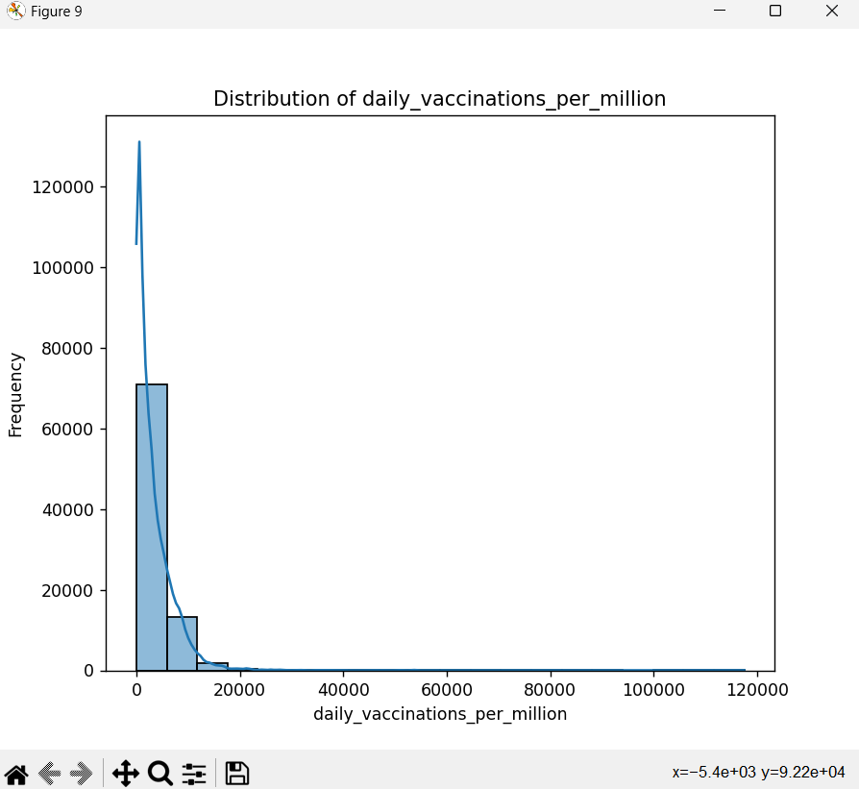
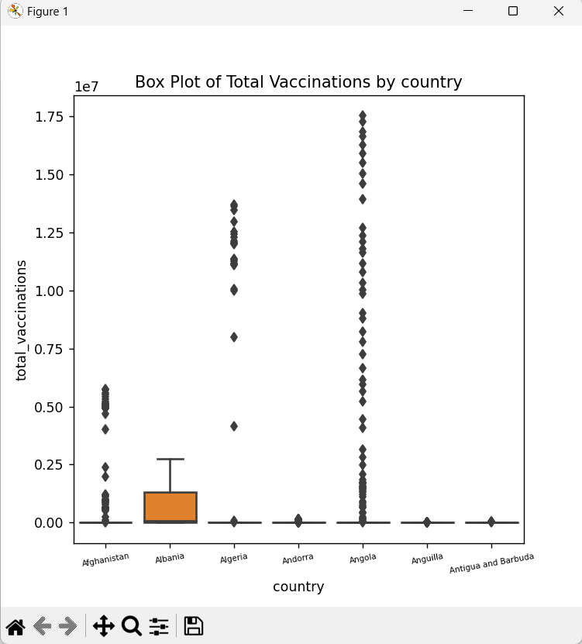
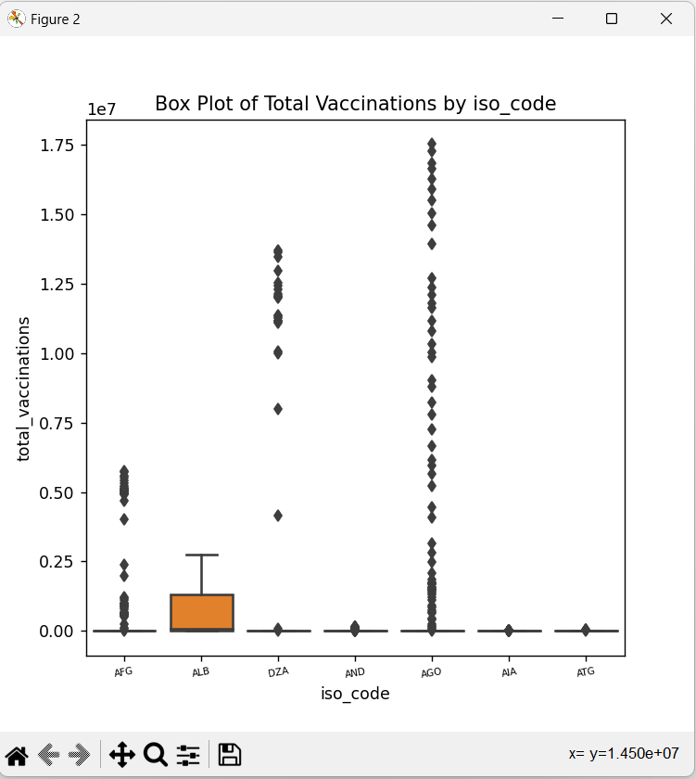
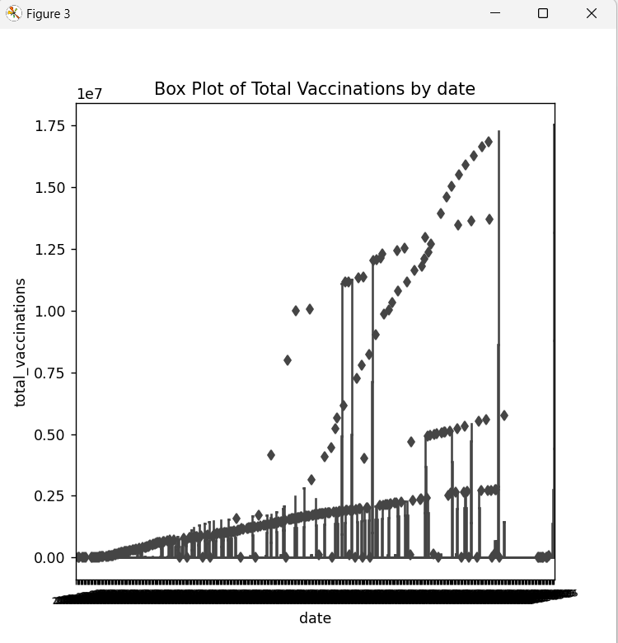

Slide 14
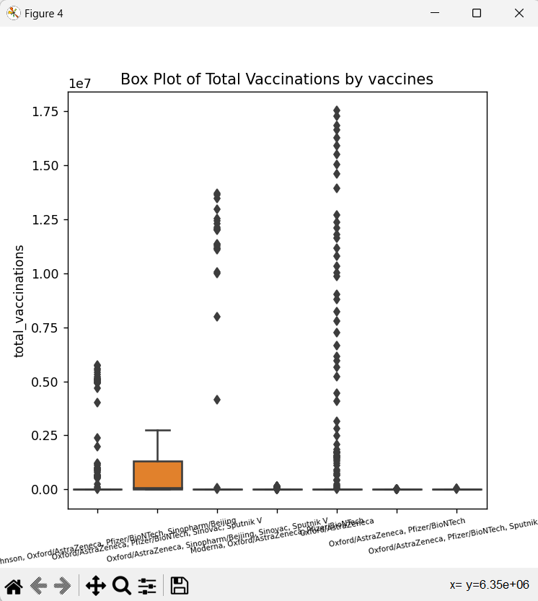
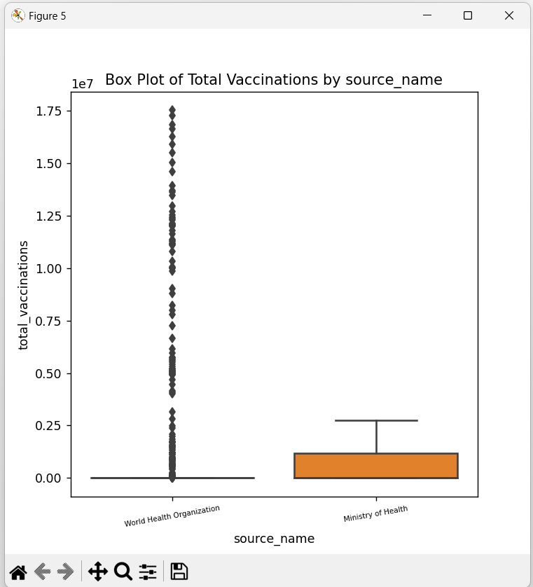
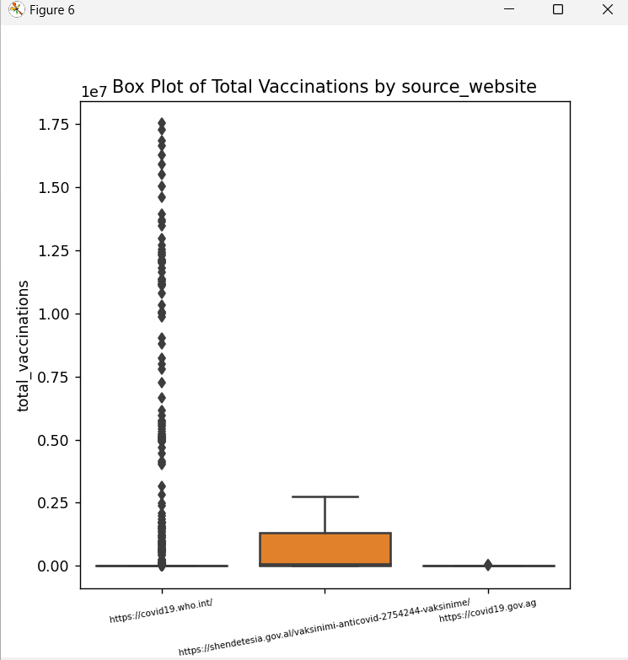
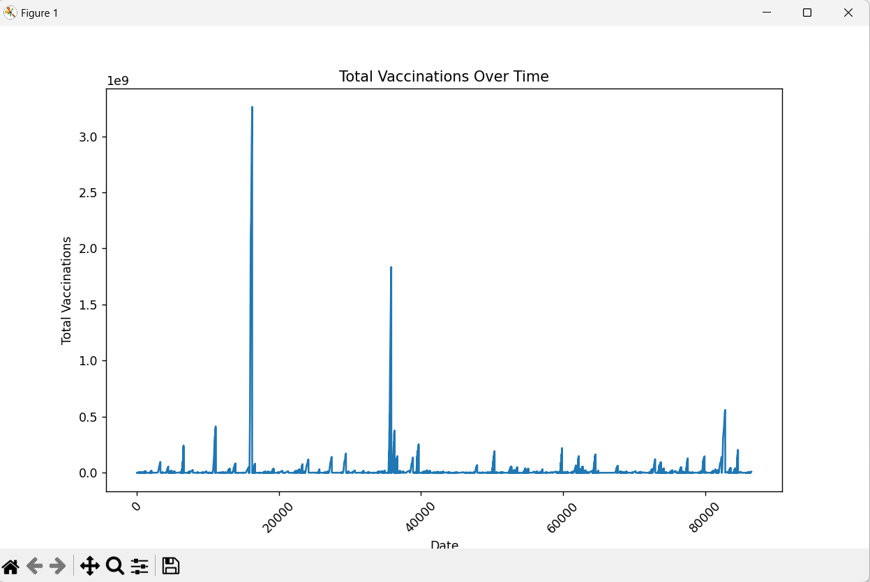

Slide 15
Program for Statistical analysis
import pandas as pd
import matplotlib.pyplot as plt
import seaborn as sns
df = pd.read_csv('data.csv')
print(df.head())
print(df.info())
print(df.describe())
df.fillna(0, inplace=True)
afghanistan_data = df[df['country'] == 'Afghanistan']
plt.figure(figsize=(12, 6))
plt.subplot(1, 2, 1)
sns.lineplot(x='date', y='total_vaccinations', data=afghanistan_data)

Slide 16
plt.title('Total Vaccinations Over Time')
plt.xlabel('Date')
plt.ylabel('Total Vaccinations')
plt.subplot(1, 2, 2)
sns.lineplot(x='date', y='daily_vaccinations', data=afghanistan_data)
plt.title('Daily Vaccinations Over Time')
plt.xlabel('Date')
plt.ylabel('Daily Vaccinations')
plt.tight_layout()
plt.show()
df.to_csv('data.csv', index=False)

Slide 17
Output:

Slide 18
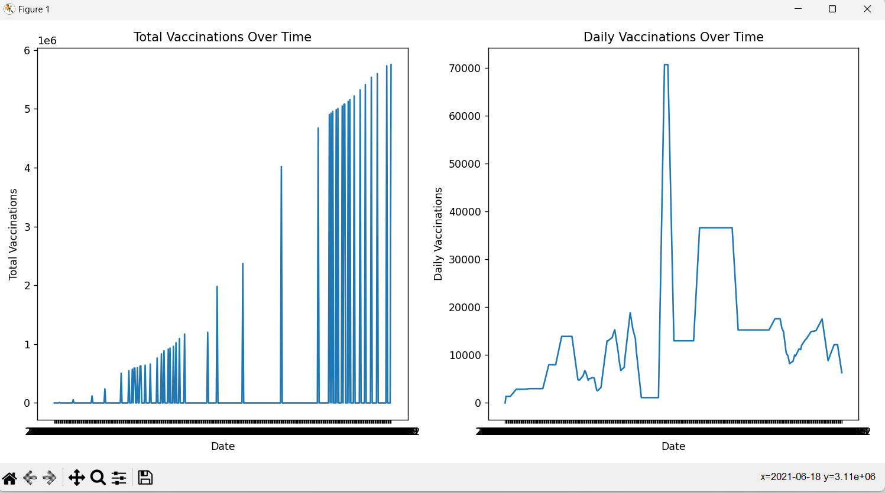

Slide 19
Program for Visualization:
import pandas as pd
import matplotlib.pyplot as plt
import seaborn as sns
url = "data.csv"
data = pd.read_csv(url)
sns.set(style="whitegrid")
plt.figure(figsize=(8, 8))
sns.barplot(x='country', y='total_vaccinations', data=data.head(200))
plt.xticks(rotation=45)
plt.title('Total Vaccinations in Top 10 Countries')
plt.xlabel('Country')
plt.ylabel('Total Vaccinations')
plt.show()
afghanistan_data = data[data['country'] == 'Afghanistan']
plt.figure(figsize=(8, 8))
sns.lineplot(x='date', y='daily_vaccinations', data=afghanistan_data[0:100])
plt.xticks(rotation=90)
plt.xticks(fontsize=6)

Slide 20
plt.title('Daily Vaccinations Trend in Afghanistan')
plt.xlabel('Date')
plt.ylabel('Daily Vaccinations')
plt.show()
plt.figure(figsize=(8, 8))
sns.scatterplot(x='total_vaccinations', y='people_vaccinated', data=data)
plt.title('Total Vaccinations vs. People Vaccinated')
plt.xlabel('Total Vaccinations')
plt.ylabel('People Vaccinated')
plt.show()
plt.figure(figsize=(8, 8))
sns.boxplot(x='vaccines', y='daily_vaccinations', data=data)
plt.xticks(rotation=90)
plt.xticks(fontsize=6)
plt.title('Distribution of Daily Vaccinations by Vaccine Type')
plt.xlabel('Vaccine Type')
plt.ylabel('Daily Vaccinations')
plt.show()

Slide 21
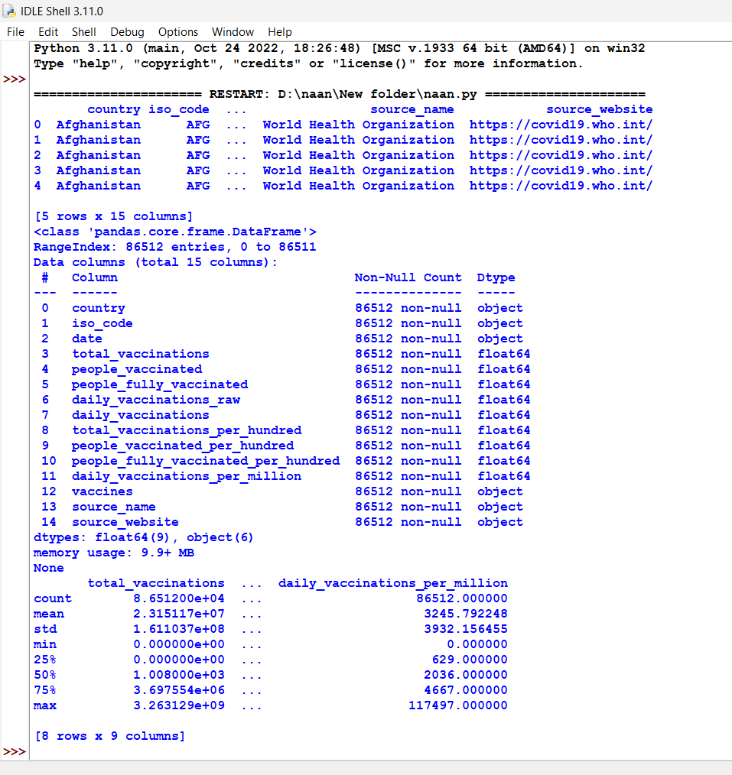
Output:

Slide 22
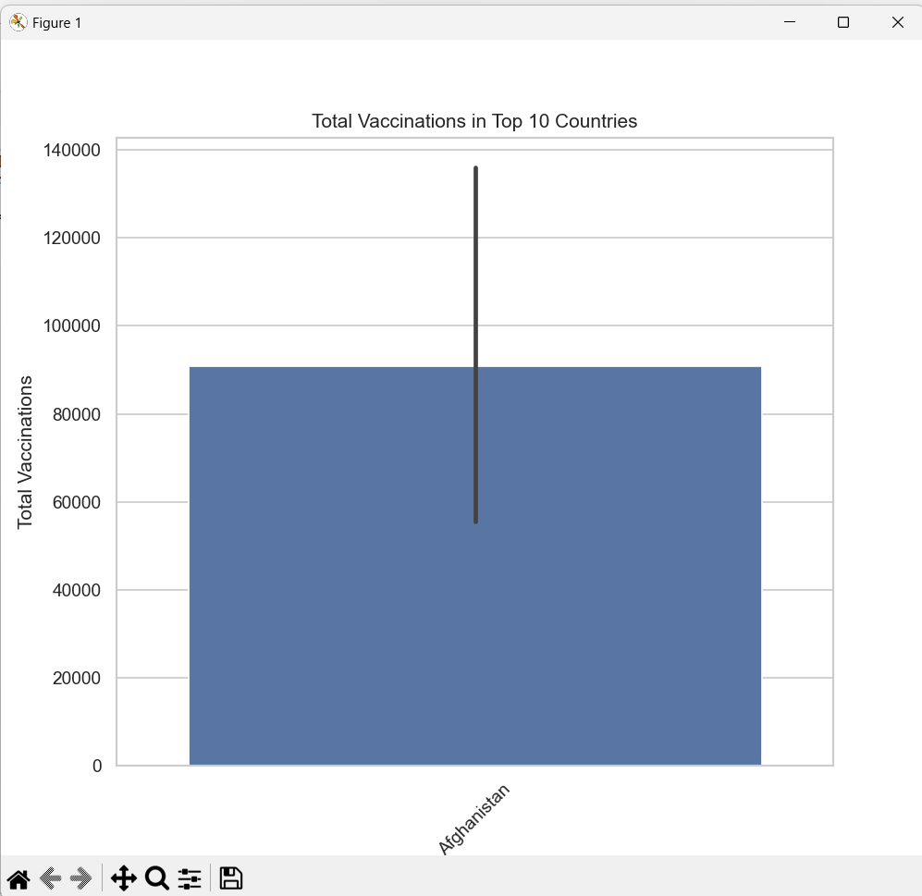
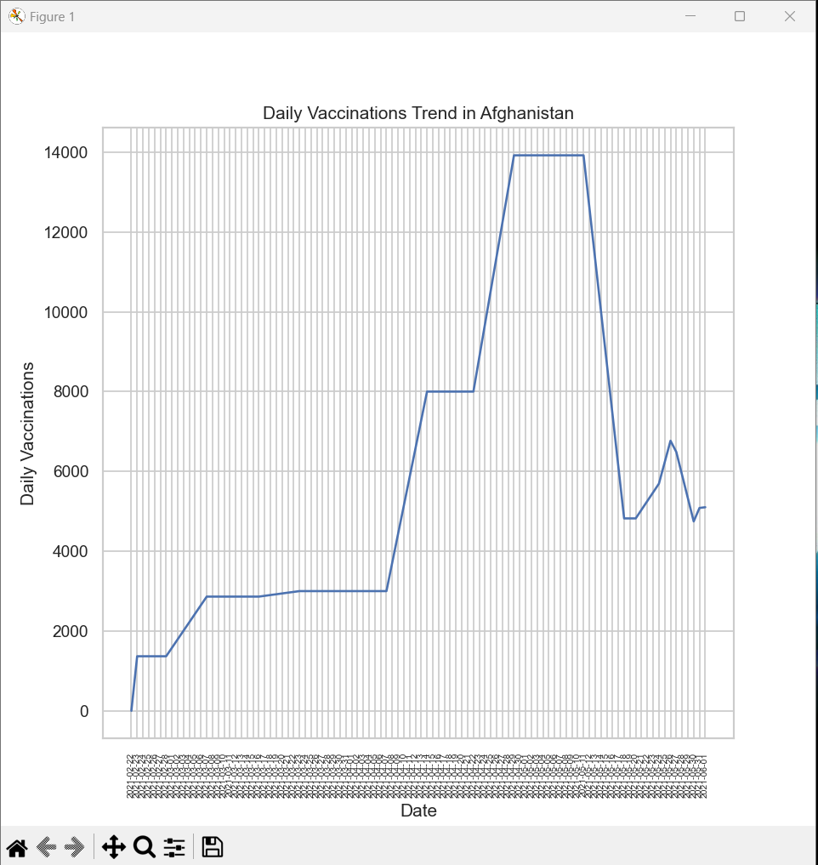
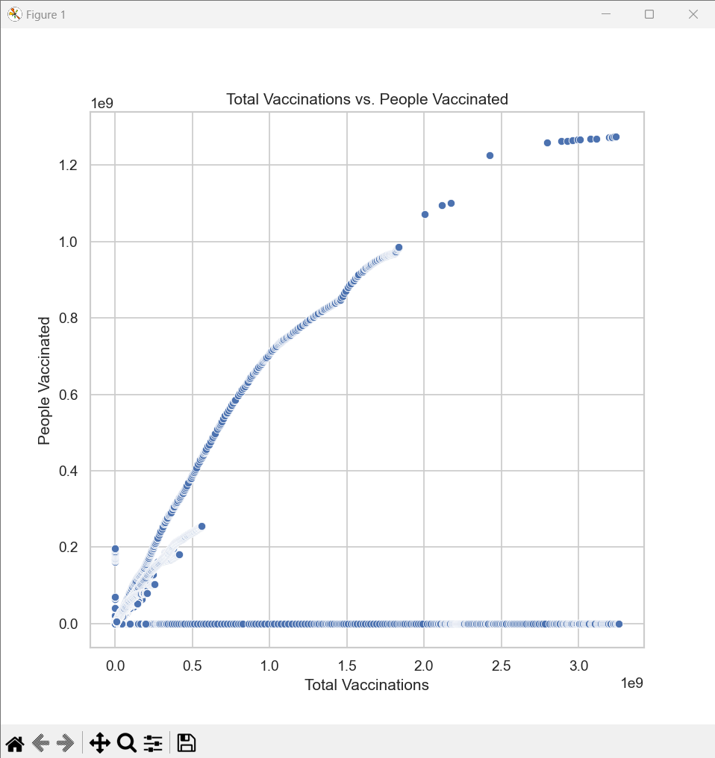
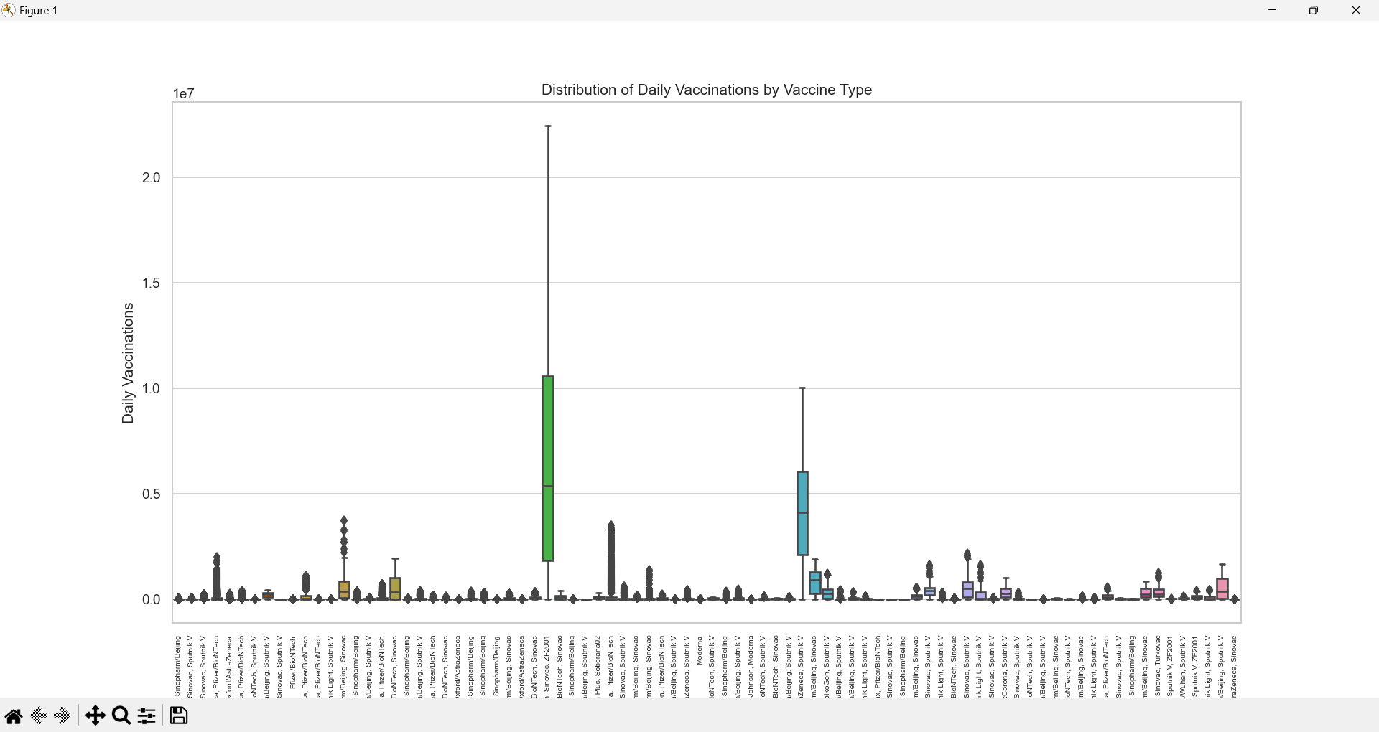

Slide 23
Conclusion
The analysis of the COVID-19 vaccine dataset has provided valuable insights into the global vaccination effort. It is evident that vaccination progress is influenced by a combination of factors, including vaccine availability, distribution strategies, and regional disparities in healthcare resources.
To improve vaccination rates worldwide and ensure equitable access to vaccines, policymakers and public health officials should consider the following:
Continuously monitor and adjust vaccination distribution strategies to address disparities.
Promote public awareness and confidence in vaccines to encourage higher uptake.
Collaborate with international organizations to ensure the availability of vaccines in underserved regions.
Use data-driven insights to optimize vaccination campaigns and target high-risk populations.
This analysis serves as a foundation for further research and policy decisions aimed at effectively combatting the COVID-19 pandemic and achieving global vaccination goals.

